Slide 1
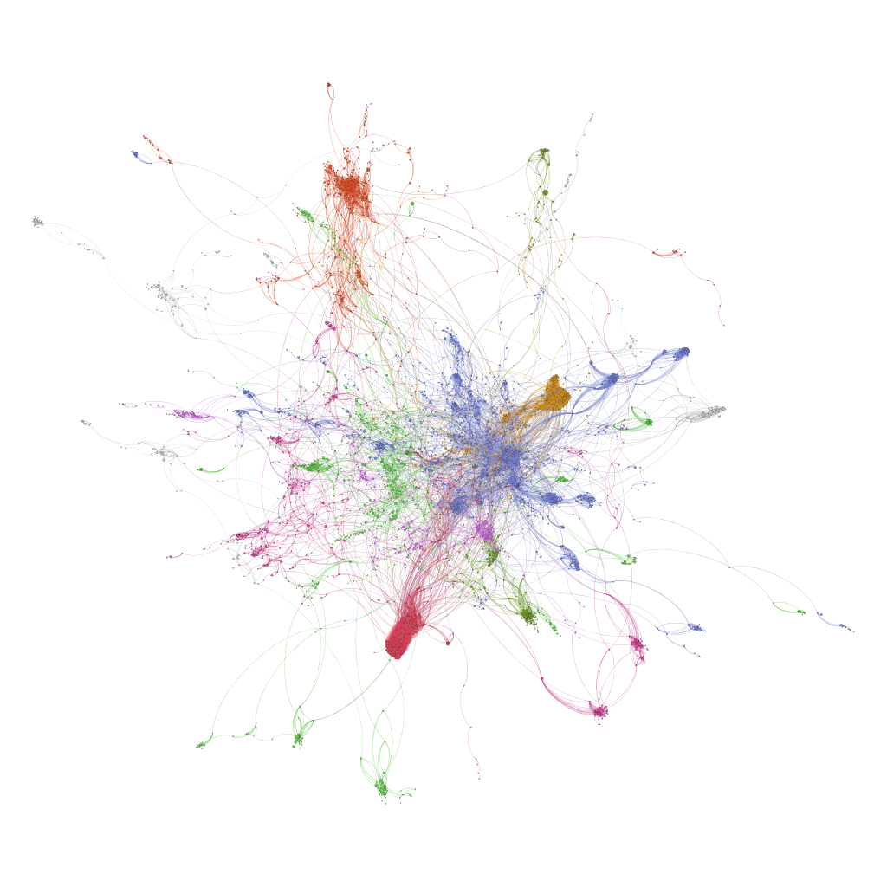
Identifying most prominent nodes in social network for information diffusion by weak nodes approach
Deepak Khirey
Network Science
Spring 2019
Community Structure in GEMSEC TVShows Facebook Page Network
Notes:
Consider talking about:
Micro level
Meso level
Macro level

Slide 2
Motivation : Which one is prominent?
To identify Top Prominent Nodes in Social Network to achieve maximum information diffusion
In social Networks Analysis, it is a very frequent question as it helps to understand many phenomenon like Rumor spreading, Viral Memes, Online Marketing, Political Messaging, Innovation Acceptance etc. [3][6]
There are several centrality measures which allow us to rank nodes based on criteria like Degree Centrality, Eigenvector Centrality, PageRank Centrality, Betweenness Centrality, Closeness Centrality to name a few.
In addition to this, we also know that if Weak nodes play a very important role in Information Diffusion. [2]
Here, I am trying to a evaluate method to identify top nodes for information diffusion by identifying community structure and weak nodes therein. [4][5]
Further I am comparing the results with top nodes identified by Betweenness centrality measure for statistical test.
Most of the previous study in this regard is done on Ego-centric networks. But I am going to use Facebook Page Network in my study. [5][7][8]

Slide 3
Introduction : Why do we care?
Consider a scenario, where a new WebSeries is being launched and we are given task of spreading word about it on Facebook. Essentially this is Facebook marketing campaign and we have to target most prominent pages on Facebook so that we reach maximum people at lowest cost.
We have a GEMSEC Facebook Page Network at disposal which lets us know underlying subscription information for Facebook Pages related to TVShows. Now we have to choose top 5 pages and place an advertisement which will reach to most subscribers in the network.
I am evaluating a method which can leverage community structure in this network. It will help us to identify weak nodes which are joining different communities and see how they perform in terms of information diffusion. [5]
Although this project uses TVShows network as example, similar approach may be taken for studying Online Social Network Analysis in any field.

Slide 4
Related Work
“Intuitively speaking, this means that whatever is to be diffused can reach a larger number of people, and traverse greater social distance (i.e., path length), when passed through weak ties rather than strong.”
Granovetter, M. S. (1973). The Strength of Weak Ties. American Journal of Sociology, Vol. 78, No. 6, 1360-1380.
“We define weak ties as those edges that, after dividing up the network into communities (thus obtaining the so-called community structure), connect vertices belonging to different communities.”
Pasquale De Meo, E. F. (November 2014). On Facebook, Most Ties Are Weak. Communications of the ACM, Vol. 57 No. 11, 78-84
“an important aspect of weak ties is their ability in enhancing information diffusion through the social network.”
Ferrara, Emilio & De Meo, Pasquale & Fiumara, Giacomo & Provetti, Alessandro. (2012). The role of strong and weak ties in Facebook: a community structure perspective. Communications of the ACM. 57. 10.1145/2629438.
“pages, networks and groups have the highest potential to be used as an information source before a purchase decision, pages should in the future become the preferred choice, because groups and networks have a restricted number of participants and advertising is prohibited.”
Maurer C., Wiegmann R. (2011) Effectiveness of Advertising on Social Network Sites: A Case Study on Facebook. In: Law R., Fuchs M., Ricci F. (eds) Information and Communication Technologies in Tourism 2011. Springer, Vienna

Slide 5
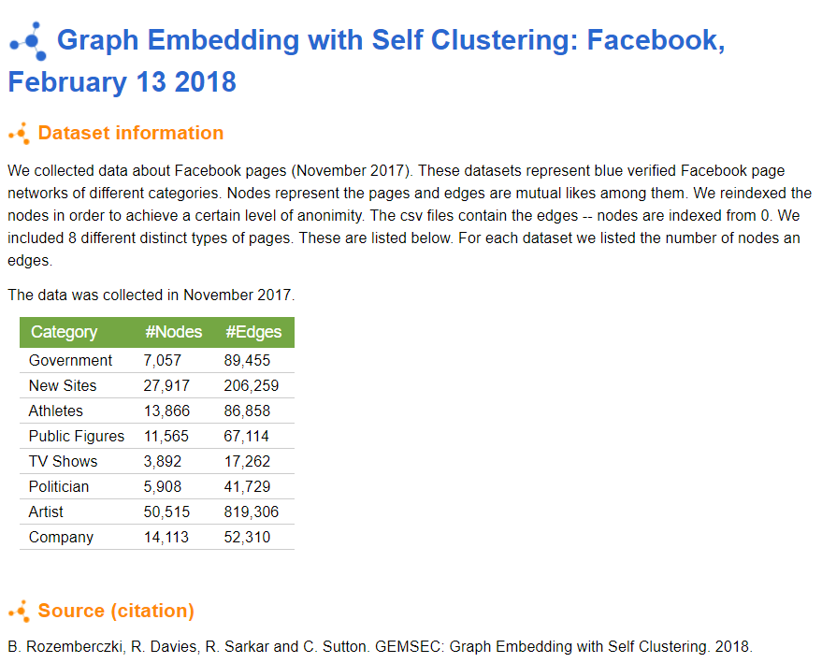
Data source
This dataset is available on snap.Stanford.edu under Stanford Large Network Dataset Collection
It is used by researchers for studying a clustering algorithm for community detection.
They call it GEMSEC: Graph Embedding with Self Clustering algorithm [8]
However, In my project I am going to use this dataset to study a method to pick top nodes for information diffusion by identifying weak nodes in the network
I am exploring if the weak nodes are equally important in a social network if it is not ego centric.
Hence I have chosen this network as this network is Facebook Page network.
Used for Current Project

Slide 6


Network Details
Nodes : Facebook Pages
Links : Mutual subscribers
Type : Undirected, unweighted
Number of Nodes : 3892
Number of Links : 17239
Nodes are anonymized by numbers, so we don’t have actual page names.
Links are unweighted, so we don’t know how many mutual subscribers are present.
Source files is in CSV format as list of links
Mutual Links – Common Subscribers
Facebook Page
Facebook Page

Slide 7
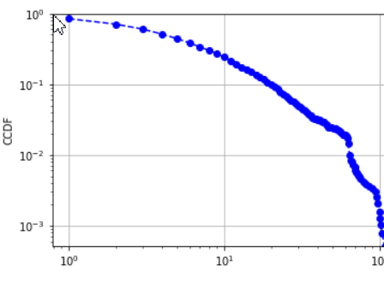
Network Details
CCDF plotted on log-log scale
Network Statistics
Average Degree : 8.859
Max Degree : 126
Average Clustering coefficient : 0.443
Average Path length : 6.276
Network Diameter : 20
Connected Components : 1
Like most of Social Networks, this network also shows scale-free characteristics
It clearly shows presence of hubs. Few number of nodes with very high degree
It also shows heavy tailed pattern in the plot

Slide 8
Statistical Test : Hypothesis
Null Hypothesis H0 : K2weaknodes = K2betweenness
There is no difference in reach if top nodes are selected by betweenness or weak node method.
Alternate Hypothesis H1 : K2weaknodes ≠ K2betweenness
There is difference in reach if top nodes are selected by betweenness or weak node method.
Parameter to test is “Reach" of top nodes which is number of unique nodes two moments away ( geodesic distance = 2 ) from selected node.
For testing the hypothesis, I am creating null graph using networkx configuration_model method. This will create pseudo graph using the degree sequence of TVShows network. Hence network characteristics are preserved during test.

Slide 9
Method of study
Detect Communities
Identify Weak Nodes
Select Weak nodes connecting multiple Communities
Calculate reach of the selected nodes
Define Configuration model
Compare results with t-statistic test
Select top nodes based on Betweenness
Get Sample of Graph

Slide 10
Sampling technique
GEMSEC Facebook Page Network for TVShows is a very large network and it is computationally challenging to perform repetitive statistical tests given limited memory resources.
Hence there is a need to perform actions on a scaled-down sample of the network
It is a scale-free network with specific degree sequence hence it is important to preserve network properties while taking samples.
I have used Snowball Sampling method. It starts with k random nodes and explores network by picking another k neighbors of sampled nodes throughout exploration until limit is reached. [9]
Further, I have repeated statistical tests on different sample sizes in multiple of 100. This is to ensure that results are tested across different network sizes.
Why Sampling?
How?

Slide 11
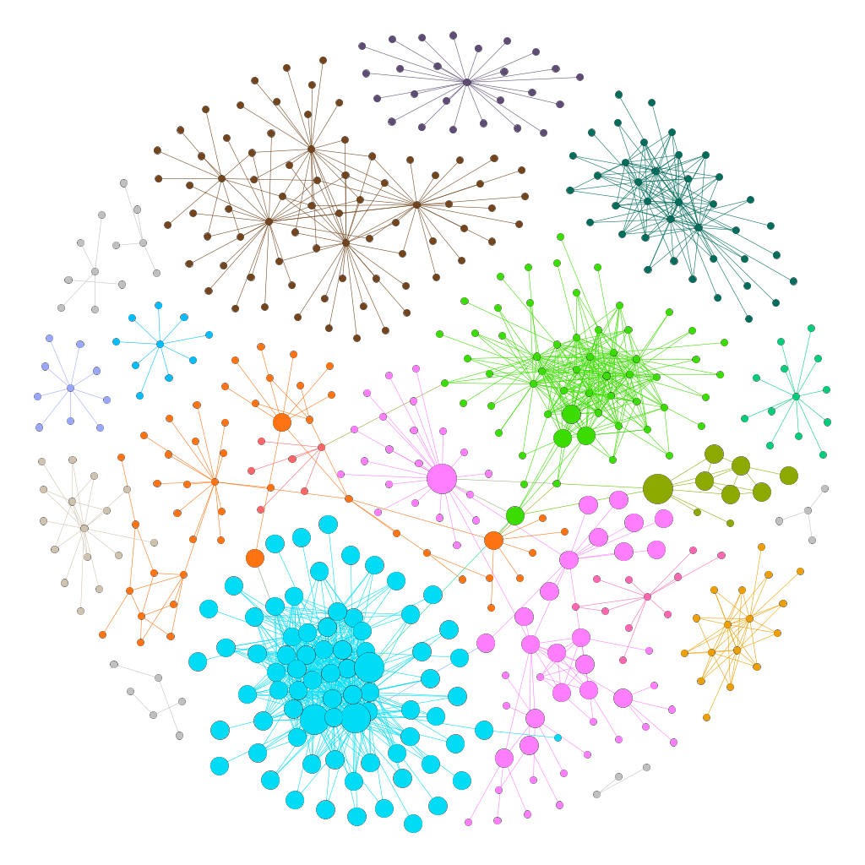
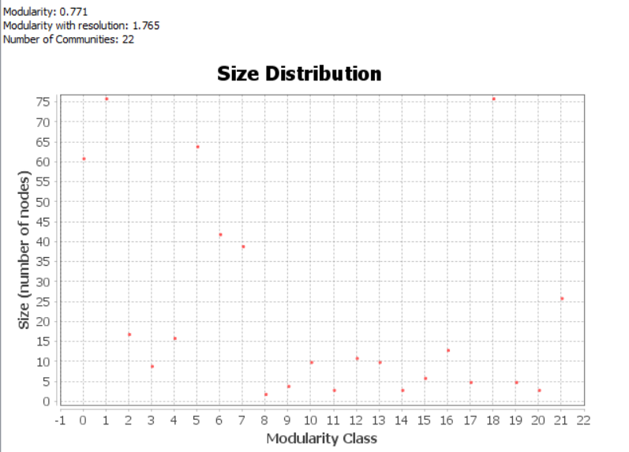
Community Detection
Nodes – 500
Edges – 948
Community Detection by Modularity Method
Resolution – 2.0
Number of communities detected – 22
Modularity – 0.771

Slide 12
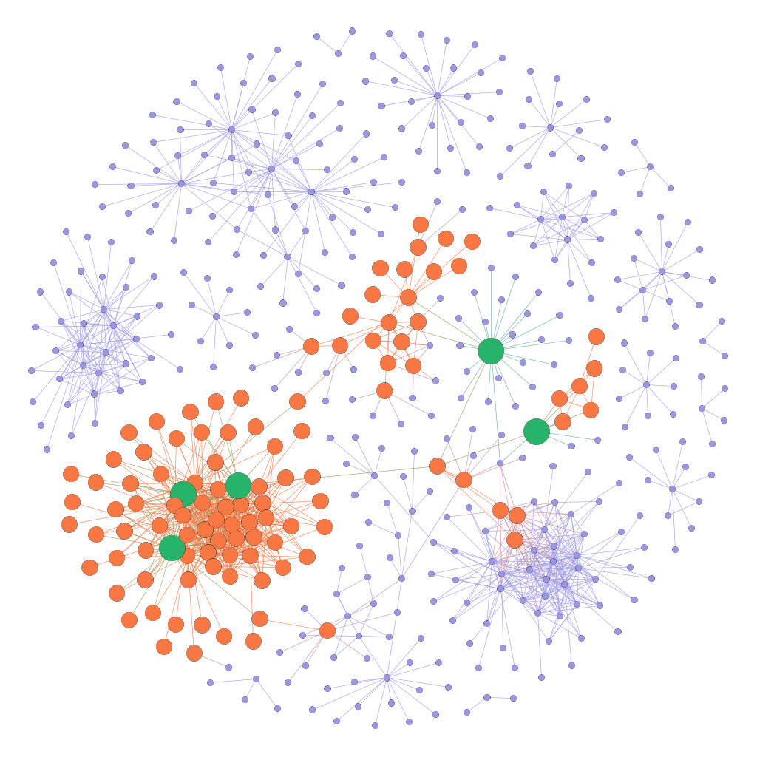
Top 5 by Weak node method and their reach
Nodes – 500
Edges – 948
Average Degree – 3.63
Top 5 Nodes - 3016,274,3122,965,126
Neighbors and Neighbors of Neighbors – 172
Percent coverage – 34.4%

Slide 13
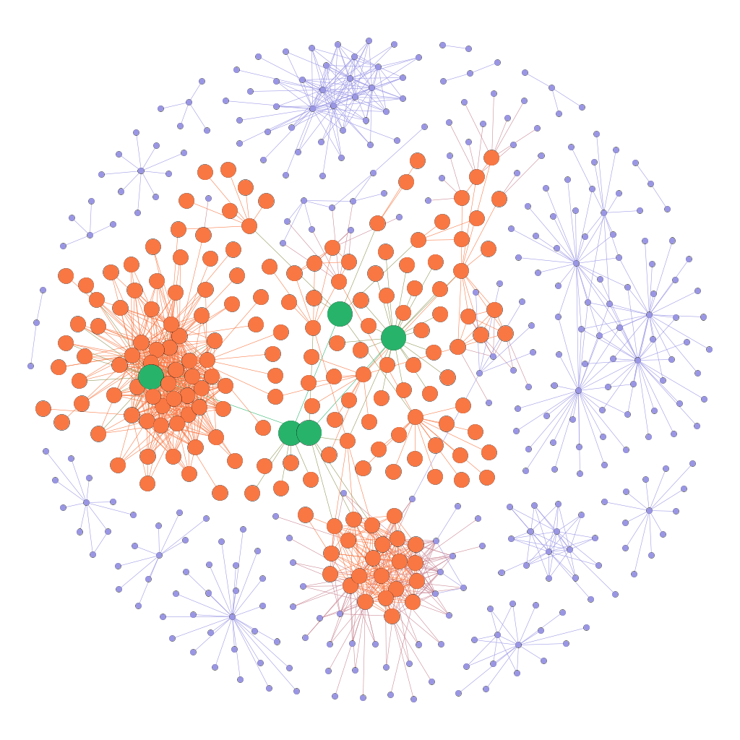
Top 5 by betweenness and their reach
Nodes – 500
Edges – 948
Average Degree – 3.63
Top 5 Nodes - 819,2170,730,2751,528
Neighbors and Neighbors of Neighbors – 239
Percent coverage – 47.8%

Slide 14
different sample sizes
Top 5 nodes selected
Sample Size | WeakNodes Method |  | Betweenness Method
 | nodes at d=2 | nodes at d=1 | nodes at d=2 | nodes at d=1
100 | 55.165 | 29.734 | 58.754 | 30.122
200 | 123.106 | 53.749 | 132.345 | 57.17
300 | 155.864 | 53.122 | 172.364 | 57.437
400 | 137.459 | 49.437 | 153.167 | 50.451
500 | 172.534 | 58.968 | 239.898 | 61.171
600 | 211.667 | 67.262 | 233.914 | 70.333
700 | 380.213 | 103.976 | 417.802 | 113.809
800 | 245.364 | 71.749 | 272.355 | 74.478
900 | 422.44 | 103.328 | 466.409 | 110.422
1000 | 363.179 | 89.086 | 404.243 | 96.049
As we select bigger sample size the reach diverges for two methods.

Slide 15
statistical test : Method and results
Applying weak node method to select top 5 nodes from sample graph and calculating their reach.
Also, applying betweenness centrality method to select top 5 nodes and calculating their reach.
Repeating such test for 100 times for every sample size for 10 different sample sizes.
Comparing two method's output using 2-sided t-test which reveals p-value.
If p-value is less than (0.05/2) 95% confidence interval, then null hypothesis is rejected showing weak nodes method is performing better.
Else, if p-value is larger then null hypothesis is not rejected meaning both methods are same in terms of output.
Top 5 nodes selected
Sample Size | t-stats | p-value | Better Method
100 | -5.43 | 0.000000408 | Betweenness
200 | -5.14 | 0.000001377 | Betweenness
300 | -4.13 | 0.000075218 | Betweenness
400 | -6.1 | 0.000000020 | Betweenness
500 | -4.32 | 0.000037719 | Betweenness
600 | -8.21 | 0.000000000 | Betweenness
700 | -6.96 | 0.000000000 | Betweenness
800 | -13.88 | 0.000000000 | Betweenness
900 | -10.69 | 0.000000000 | Betweenness
1000 | -10.08 | 0.000000000 | Betweenness

Slide 16
Selecting more top nodes
Sample Size – 500 Nodes
Top Nodes | Weak Nodes Method | Betweenness Method
5 | 172 | 239
10 | 231 | 327
15 | 332 | 339
20 | 335 | 342
As we select more top nodes the reach converges for two methods.
For top 5 nodes there is significant difference 172 vs 239
For top 20 nodes they is marginal difference 335 vs 342

Slide 17
different networks
Top 5 nodes selected
Network | Weak Nodes Method | Betweenness Method
tvshows | 1094 | 1212
politician | 3197 | 3277
company | 4830 | 4773
publicfigures | 6583 | 6583
government | 5040 | 5039
atheletes | 7871 | 7896
newsites | 14735 | 15374
Weak Nodes are able to achieve significant Information Diffusion across networks
It shows marginal difference in Reach in case of smaller network
For larger networks weak node method shows lesser reach than betweenness method

Slide 18
Pros and cons
Weak Nodes Method
prior knowledge of community structure helps to target or avoid certain parts of network during campaign
Community detection based on modularity needs optimization because optimum Resolution value is different for different network
Repeatability is not reliable as community detection differs in each experiment leading to different outputs
PROS
CONS

Slide 19
Future work
Things to Improve
It is possible to check results with further different sampling strategies. [9]
Community detection based on Modularity can be optimized using advanced machine learning methods to find out exact maxima [5]
Different community detection algorithms such as Louvain method or Infomap can be used for comparison of results [4]
I have used GEMSEC Facebook Page Network graphs for comparison of methods. It can be applied to many other social network graphs for validation such as Twitter, LinkedIn, Instagram etc.
I have computation limitation due to computer configuration, experiment can be done with more sophisticated computers

Slide 20
conclusion
Identifying top nodes for information diffusion by detecting community structure in the network and selecting weak nodes is a very effective method.
It shows that the reach achieved by this method is comparable to that of top nodes by betweenness centrality.
It is possible to select totally different set of top nodes and achieve similar reach within the network.
Top nodes responsible for Information Diffusion may not be the ones with higher Degree Centrality. This study shows that they may be ones with higher Betweenness Centrality or weak nodes joining multiple communities.
Weak nodes method is useful for targeted online social campaigns where community structure can be leveraged to reach or avoid specific user population.
Effectiveness of weak nodes method depends largely on ability to detect community structure.
Sampling technique affects the result of statistical test hence a consistent method needs to be adopted.
Weak nodes method can be applied to any form of social network like egocentric friendship network or page network.

Slide 21
References
Barthélemya, M. (2004). Betweenness centrality in large complex networks. Eur. Phys. J. B 38, 163-168.
Granovetter, M. S. (1973). The Strength of Weak Ties. American Journal of Sociology, Vol. 78, No. 6, 1360-1380.
Nouh, M., & Nurse, J. R. (2015). Identifying Key-Players in Online Activist Groups on the Facebook Social Network. IEEE International Conference on Data Mining Workshop (ICDMW). Atlantic City, NJ, USA : IEEE.
Pasquale De Meo, E. F. (November 2014). On Facebook, Most Ties Are Weak. Communications of the ACM, Vol. 57 No. 11, 78-84.
Ferrara, Emilio & De Meo, Pasquale & Fiumara, Giacomo & Provetti, Alessandro. (2012). The role of strong and weak ties in Facebook: a community structure perspective. Communications of the ACM. 57. 10.1145/2629438.
Maurer C., Wiegmann R. (2011) Effectiveness of Advertising on Social Network Sites: A Case Study on Facebook. In: Law R., Fuchs M., Ricci F. (eds) Information and Communication Technologies in Tourism 2011. Springer, Vienna
Wohlgemuth, J., & Matache, M. T. (2014). Small-world properties of facebook group networks. Complex Systems, 23(3), 197-225.
Rozemberczki, Benedek & Davies, Ryan & Sarkar, Rik & Sutton, Charles. (2018). GEMSEC: Graph Embedding with Self Clustering.
M. Gjoka, M. Kurant, C. T. Butts and A. Markopoulou, "Walking in Facebook: A Case Study of Unbiased Sampling of OSNs," 2010 Proceedings IEEE INFOCOM, San Diego, CA, 2010, pp. 1-9.

Slide 22


